Slide 1

MACHINE LEARNING (CS 603)
MINOR PROJECT
COURSE CO-ORDINATOR: PROF. ARUNA TIWARI

Slide 2
LOG-LINEAR REGRESSION BASED MACHINE LEARNING PREDICTION OF NUSSELT NUMBER FOR FORCED CONVECTION OVER A FLAT PLATE
Submitted by:
1. Abhishek Yadav (2502103031)
2. Arshdeep Singh (2502103033)
3. Prateek Bajpai (2502103036)
4. Dilip Rathva (2502103039)

Slide 3
OBJECTIVE
To develop a machine learning model for predicting the Nusselt number and convective heat transfer coefficient for forced convection over a flat plate.
To generate a realistic heat transfer dataset for different fluids (air, water, and oil) by varying key flow and thermal parameters.
To analyze fluid-wise prediction accuracy for different categories of fluids and compare their heat transfer behavior.

Slide 4
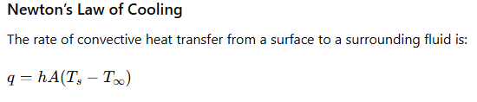
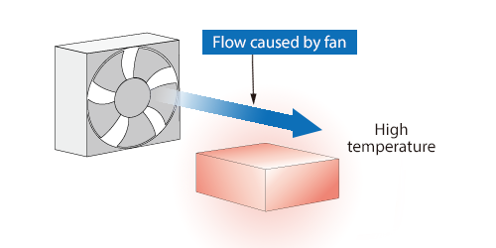
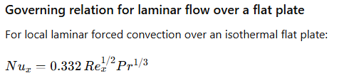
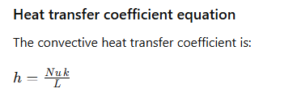
GOVERNING RELATIONS
Forced Convection
https://www.cradle-cfd.com/technology/glossary/ja_F/detail0053.html

Slide 5
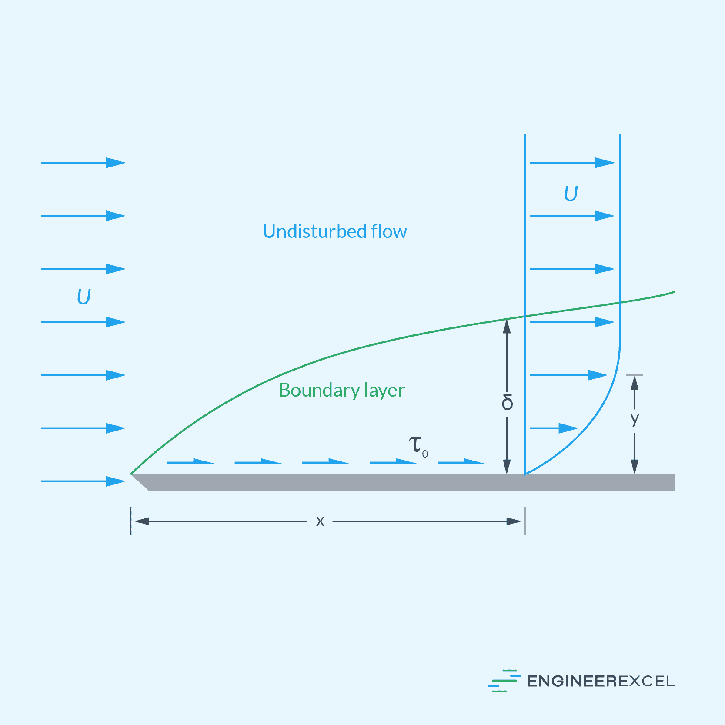
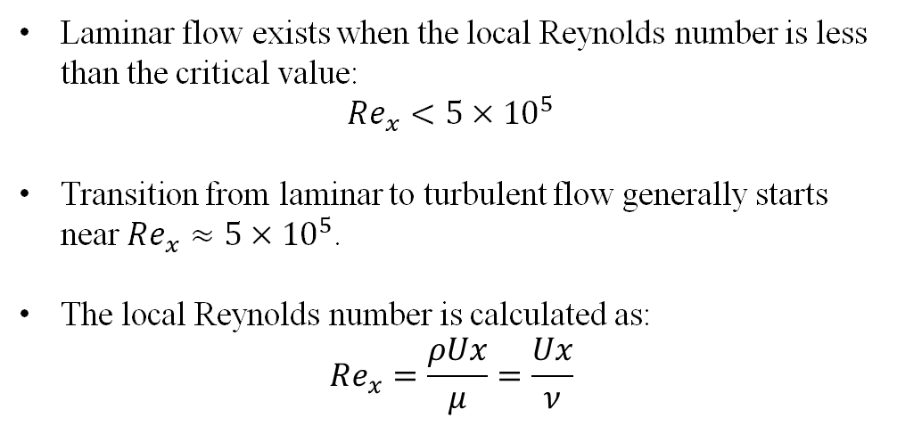
FLOW OVER A FLAT PLATE
Laminar flow exists when the local Reynolds number is less than the critical value:
$$Re_{x}<5×{10}^{5}$$
Transition from laminar to turbulent flow generally starts near $Re_{x}≈5×{10}^{5}$.
The local Reynolds number is calculated as:
$Re_{x}=\frac{ρUx}{μ}=\frac{Ux}{ν}$
Laminar Boundary Region
https://engineerexcel.com/laminar-flow-over-flat-plate/

Slide 6
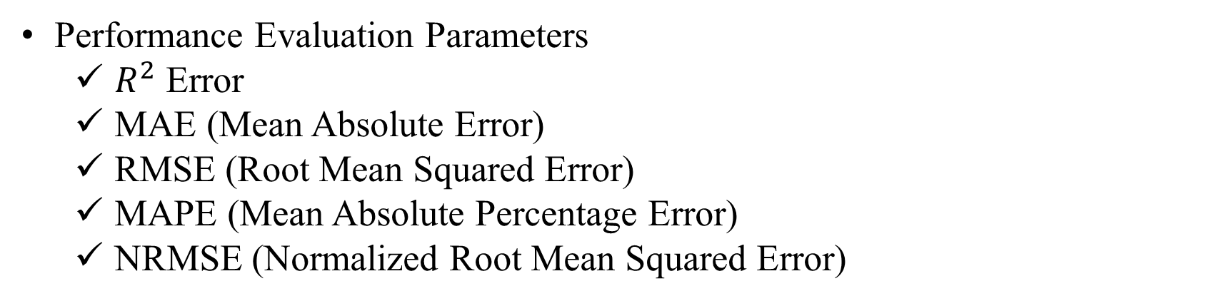
ML PROBLEM FORMULATION
Type: Supervised Learning
  Log-Linear Regression
  Input Features: Reynolds number (Re), Prandtl number (Pr)
  Target Output: Nusselt Number (Nu)
Performance Evaluation Parameters
  $R^{2}$ Error
  MAE (Mean Absolute Error)
  RMSE (Root Mean Squared Error)
  MAPE (Mean Absolute Percentage Error)
  NRMSE (Normalized Root Mean Squared Error)

Slide 7
DATA COLLECTION AND PRE-PROCESSING
Labelled dataset using empirical correlations
  Dataset size: 10,000 samples
  Features: Reynolds number, Prandtl number
  Log transformation for linear regression
Pre-processing
  Classification of the dataset into water-like, air and oil types
  Scaling of the dataset using sklearn method
  Introduced 10% noise in the dataset to replicate real experimental conditions

Slide 8
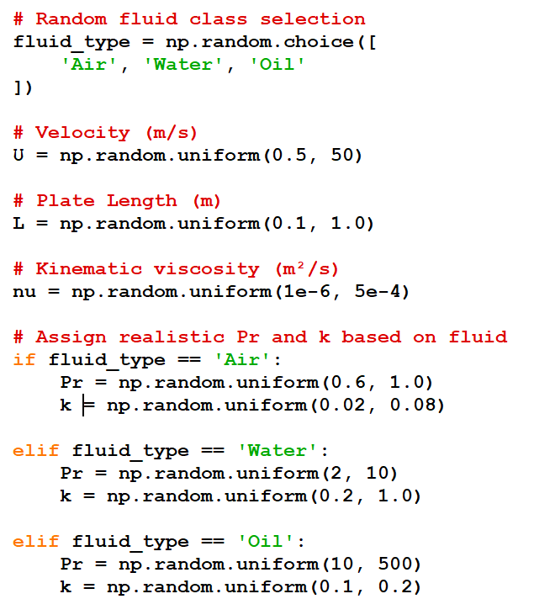
RANGE OF VARIOUS PARAMETERS

Slide 9
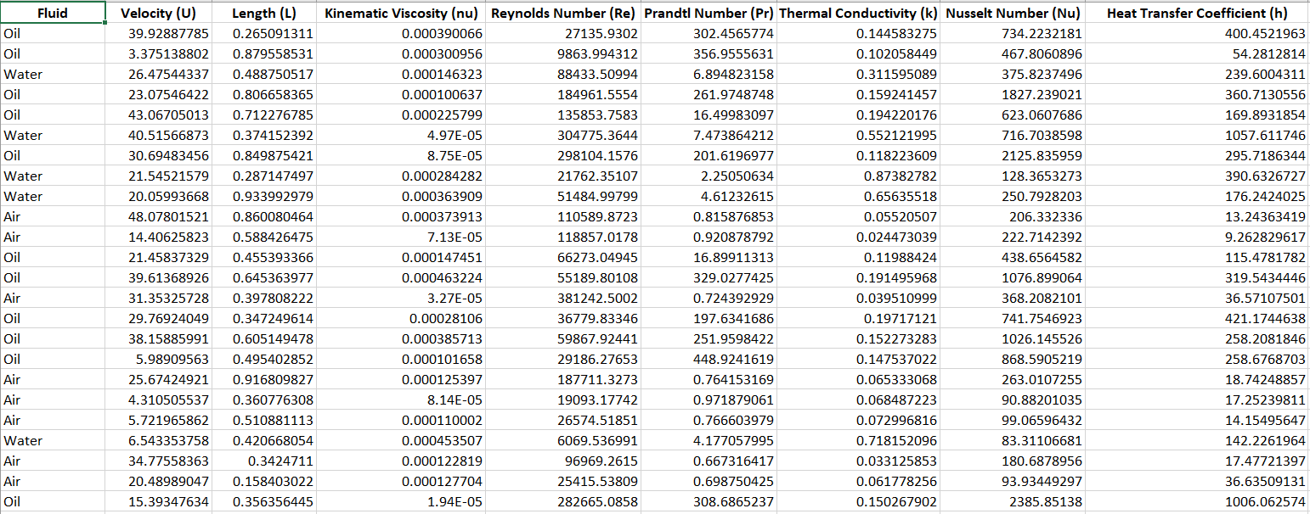
SAMPLE DATASET

Slide 10
TRAINING AND PROCESSING
Applied logarithmic transformation to linearize the heat transfer correlation.
Split dataset into training and testing sets for model development and validation.
Trained a log-linear regression machine learning model for Nusselt number prediction.
Evaluated model using R², MAE, RMSE, MAPE, and NRMSE.
Performed 5-fold cross-validation to check model generalization.

Slide 11
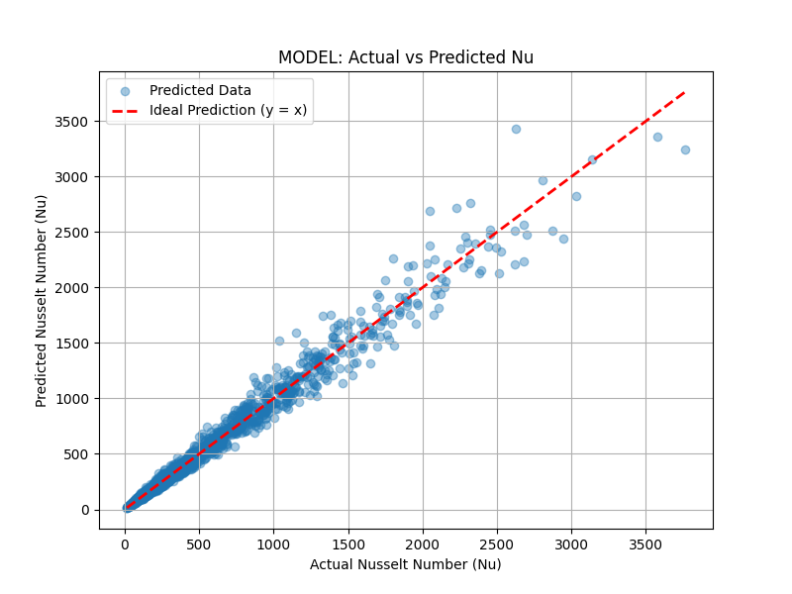
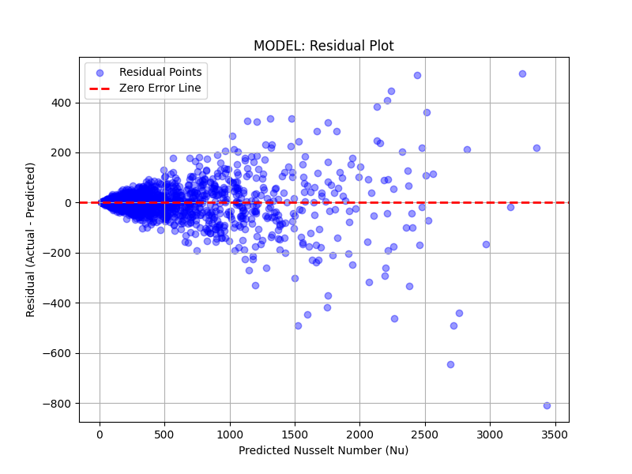
POST PROCESSING AND RESULTS
Actual vs Predicted Nusselt Number
Residual Plot

Slide 12
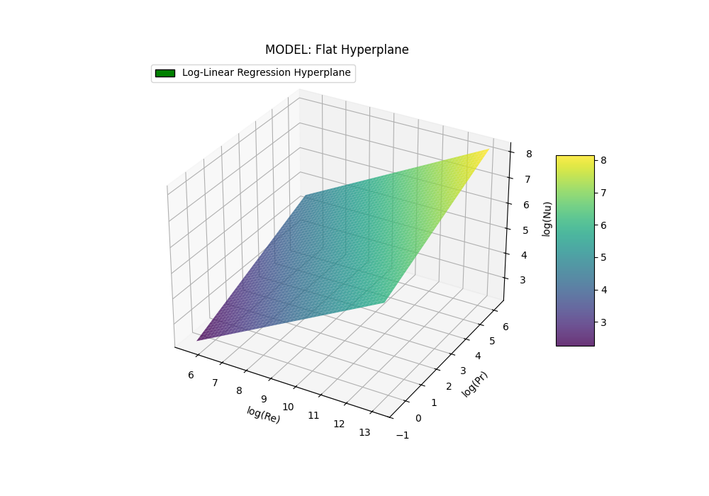
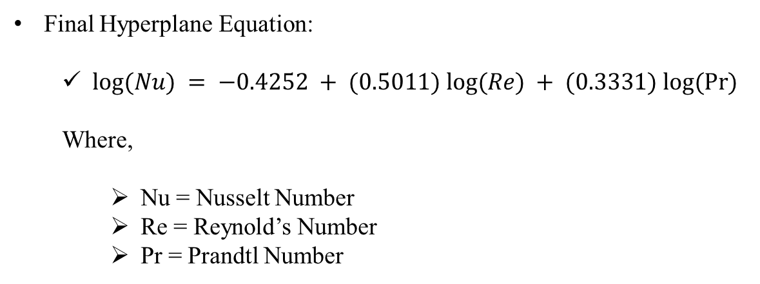
POST PROCESSING AND RESULTS
Final Hyperplane Equation:
  $log⁡(Nu) = −0.4252 + (0.5011) log⁡(Re) + (0.3331) log⁡(Pr)$
  Where,
    Nu = Nusselt Number
    Re = Reynold’s Number
    Pr = Prandtl Number
Hyperplane Visualization

Slide 13
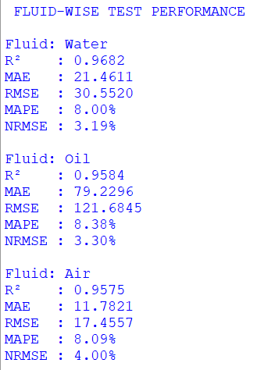
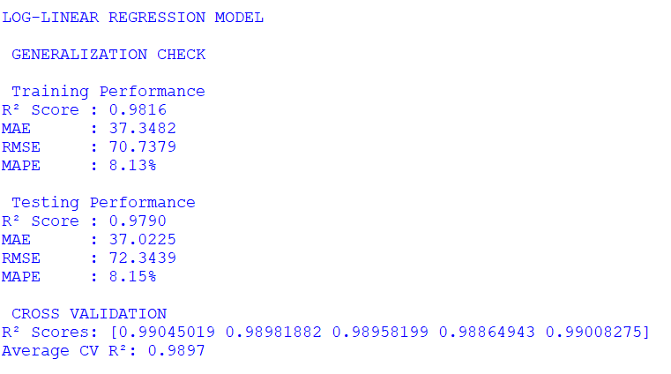
RESULTS

Slide 14
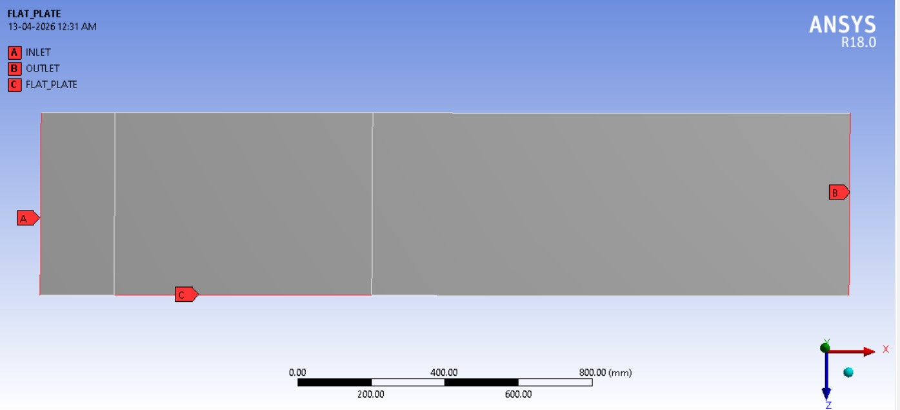
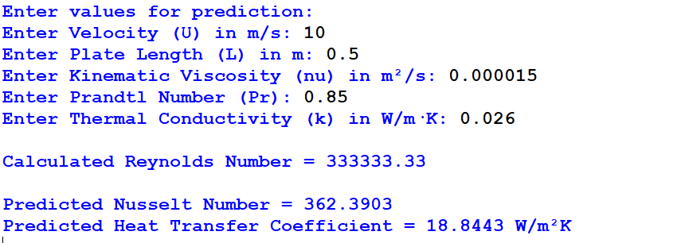

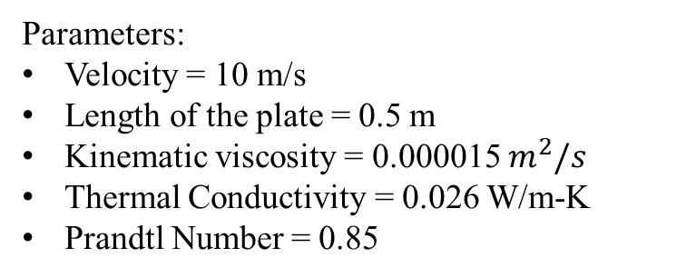
VALIDATION WITH CFD
Parameters:
Velocity = 10 m/s
Length of the plate = 0.5 m
Kinematic viscosity = 0.000015 $m^{2}/s$
Thermal Conductivity = 0.026 W/m-K
Prandtl Number = 0.85
CFD Result
ML Model Prediction

Slide 15
REFRENCES
C. Caron, P. Lauret and A. Bastide, Build. Environ. 2025, 267, 112229.
Y. A. Çengel and A. J. Ghajar, Heat and Mass Transfer: Fundamentals and Applications, 5th ed., McGraw-Hill, New York, 2015.

Slide 16


